Slide 1
SINGULARITY

Slide 2
WHAT IS SINGULARITY?
The singularity is a potential future in which we see technology expand beyond human control. It promises unfathomable changes to life.
There are plenty of works of fiction warning us against the singularity, the future of robots, and of AI. But the singularity might not be as much of threats as it sounds.
So, will the singularity happen? If any of these four arguments are to be believed, the answer is no.

Slide 3
The Argument for a Singularity
1. Diminishing returns
The singularity predicts that technology growth will accelerate out of our control as it learns to improve itself. (Particularly in the case of machine intelligence.) But this ignores the role of diminishing returns.
So, will the singularity happen? No, because diminishing returns mean that it doesn’t matter how many times a future AI improves itself. The scale of each improvement won’t be enough to spark the singularity.

Slide 4
The Argument for a Singularity
2. Anthropocentric
philosophical viewpoint arguing that human beings are the central or most significant entities in the world.
The singularity puts human intelligence on a pedestal. That is, it views human intelligence as a special ‘tipping point’. Once the machines reach it, we will face the singularity. The anthropocentric argument criticizes this logic.

Slide 5
The Argument for a Singularity
Anthropocentrism is the belief that humans are the most important entity in the universe. There have been plenty of instances where an anthropocentric belief has proved flawed. For instance, the sun doesn’t revolve around us, we evolved from apes — we aren’t higher beings.
The anthropocentric argument points out that we have no real reason to assume that human intelligence is some ultimate and unchallengeable level. Even if we do accept that human-level intelligence is special, it doesn’t mean that it’s the tipping point for singularity.

Slide 6
The Argument for a Singularity
3. Limits of intelligence
Or, we can take it the other way. That is, humans are special and there’s only so far intelligence can go. (I.e. the level of human intelligence.)
The ‘limits of intelligence’ argument recognize that there are many limits within the universe. For instance, you cannot accelerate past the speed of light.

Slide 7
The Argument for a Singularity
So, then, advancements in AI may hit a fundamental limit of intelligence. This is another argument surrounding the ‘will the singularity happen’ question that suggests the answer is no.
Intelligence is a complex phenomenon that may well be walled. Human intelligence is likely not at (or close to) this potential wall. However, there’s no real evidence to suggest that the limit of intelligence is so stupendously far past human ability that a singularity is possible.

Slide 8
The Argument for a Singularity
4. ‘Fast-thinking dog’
Yes, machines can perform calculations much faster than humans. And yes, they’re getting ever-quicker with ever-more complex computations.
Cue the fast-thinking dog argument: just because machines are faster, it doesn’t mean they’re smarter. Speed does not equate to intelligence.

Slide 9
The Intelligence explosion without intelligence
The intelligence explosion idea was expressed by statistician I.J. Good in 1965:
Let an ultra-intelligent machine be defined as a machine that can far surpass all the intellectual activities of any man however clever. Since the design of machines is one of these intellectual activities, an ultra-intelligent machine could design even better machines; there would then unquestionably be an ‘intelligence explosion, and the intelligence of man would be left far behind. Thus, the first ultra-intelligent machine is the last invention that man need ever make.
The argument is this: Every year, computers surpass human abilities in new ways.

Slide 10
The Intelligence explosion without intelligence
A program written in 1956 was able to prove mathematical theorems, and found a more elegant proof for one of them than Russell and Whitehead had given in Principia Mathematica.
By the late 1990s, ‘expert systems’ had surpassed human skill for a wide range of tasks. In 1997, IBM’s Deep Blue computer beat the world chess champion.
In 2011, IBM’s Watson computer beat the best human players at a much more complicated game: Jeopardy . Recently, a robot named Adam was programmed with our scientific knowledge about yeast, then posed its own hypotheses, tested them, and assessed the results.

Slide 11
The Intelligence explosion without intelligence
Computers remain far short of human intelligence, but the resources that aid AI design are accumulating (including hardware, large datasets, neuroscience knowledge, and AI theory).
We may one day design a machine that surpasses human skill at designing artificial intelligences. After that, this machine could improve its own intelligence faster and better than humans can, which would make it even more skilled at improving its own intelligence.
This could continue in a positive feedback loop such that the machine quickly becomes vastly more intelligent than the smartest human being on Earth: an ‘intelligence explosion’ resulting in a machine superintelligence.

Slide 12
The Intelligence explosion without intelligence
In 2011, IBM’s Watson computer beat the best human players at a much more complicated game: Jeopardy . IBM's Watson supercomputer soundly defeated its human opponents in the final round of man vs. machine on the Jeopardy TV show. The computer defeated Jeopardy champions Ken Jennings and Brad Rutter, after a three-night tournament that drew lots of chatter about the progress of artificial intelligence.
For each possible answer, Watson finds evidence that may support or refute that answer. So for each of hundreds of possible answers it finds hundreds of bits of evidence and then with hundreds of algorithms scores the degree to which the evidence supports the answer.

Slide 13
Obstacles to the singularity
Brain Emulation:
Whole Brain Emulation (WBE) or ‘mind uploading’ is a computer emulation of all the cells and connections in a human brain.
So even if the underlying principles of general intelligence prove difficult to discover, we might still emulate an entire human brain and make it run at a million times its normal speed (computer circuits communicate much faster than neurons do).
Such a WBE could do more thinking in one second than a normal human can in 31 years. So, this would not lead immediately to smarter-than-human intelligence, but it would lead to faster-than-human intelligence.

Slide 14
Obstacles to the singularity
A WBE could be backed up (leading to a kind of immortality), and it could be copied so that hundreds or millions of WBEs could work on separate problems in parallel.
If WBEs are created, they may therefore be able to solve scientific problems far more rapidly than ordinary humans, accelerating further technological progress.

Slide 15
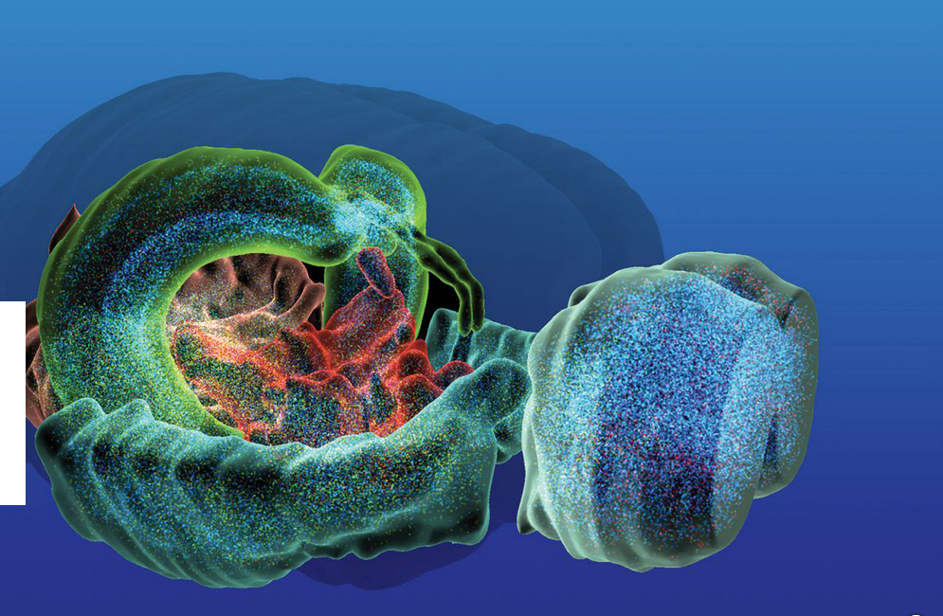
Obstacles to the singularity
Blue Brain Project:

Slide 16
Obstacles to the singularity
The goal of the Blue Brain Project is to build biologically detailed digital reconstructions and simulations of the mouse brain.
EPFL’s Blue Brain Project is a Swiss brain research Initiative led by Founder and Director Professor Henry Markram.
The aim of Blue Brain is to establish simulation neuroscience as a complementary approach alongside experimental, theoretical and clinical neuroscience to understanding the brain, by building the world’s first biologically detailed digital reconstructions and simulations of the mouse brain.

Slide 17
Obstacles to the singularity
The project’s novel research strategy exploits interdependencies in the experimental data to obtain dense maps of the brain, without measuring every detail of its multiple levels of organization (molecules, cells, micro-circuits, brain regions, the whole brain).
This strategy allows the project to build digital reconstructions (computer models) of the brain at an unprecedented level of biological detail.

